Slide 1


AGENTIC AI | DATA ENGINEERING
The AI-in-Data Engineering Program
Program Overview · the two agents, end to end
Two agents on one governed
Databricks platform
August 2026
Proprietary and Confidential
Notes:
ACFC-formatted program overview. Architecture slides depict the target shape inside AmeriHealth's own Databricks account.

Slide 2

PROGRAM OVERVIEW
AGENDA
01
How the two agents fit together
One relay from an approved FRD through to generated pipeline code — with a human gate at each hand-off
02
STTM Agent Overview and Demo
The source-to-target mapping workbook, filled in from the approved FRD and returned to SharePoint
03
CodeGen /Data Engineer Agent Overview and Demo
04
Next Steps and Prioritize Agent Training and Deployment
2

Slide 3
TEAM INTRODUCTIONS
Dedicated POD for this program
Raj Gokaraju
Oliver Doren
Sponsor
Databricks Solution Architect
PARTNER/
CLIENT COUNTERPARTS
Reviews sample BRDs / FRDs / STTMs;
leads output acceptance and UAT sign-off.
Shares sample BRDs, FRDs and STTMs — the seed corpus for agent grounding.
HEXAWARE DELIVERY POD
Venu Anumolu/Ram Kuchana
AI Engineer 1 (Arjun Pillai)
AI Engineer 2 (Soham Banerjee)
Engagement Lead
Dedicated — 100%
Dedicated — 100%
FRD - STTM Agent ·
CodeGen / Data Engineer
Scope, plan, client alignment, solution architecture guidance and escalations.
2
Cadence: Daily pod stand-up · weekly client status · bi-weekly demos & SME checkpoints · monthly steering.

Slide 4
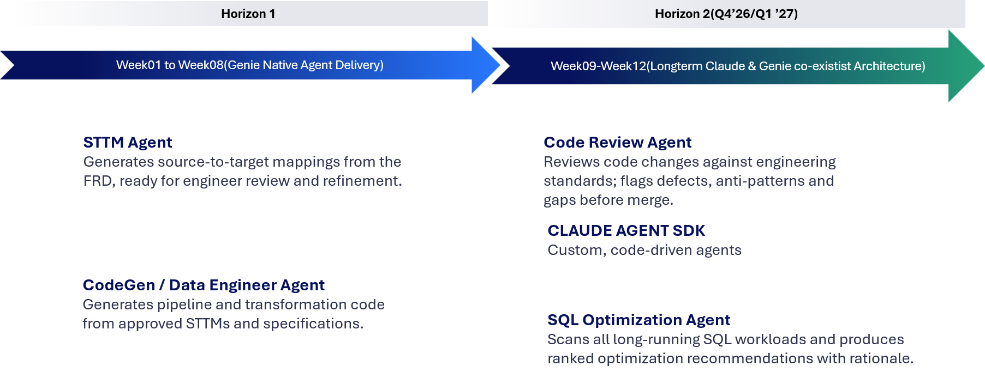
Agents Scope
Four agents, two waves — all live by Jan 31, 2026
AMERIHEALTH CARITAS | PROPRIETARY AND CONFIDENTIAL
4

Slide 5



THE PROGRAM AT A GLANCE
Two agents, one relay — from an approved FRD through to generated pipeline code
Agent 1
Agent 2
FRD
FRD → STTM
STTM
CodeGen
Pipeline code
approved,
in SharePoint
workbook,
in SharePoint
transforms, DDL,
tests, job config
human gate
human gate
The FRD is authored and approved by your team. Agent 1's workbook is Agent 2's input — and nothing moves downstream until a named person approves it.
FRDs and STTM workbooks are read from, and written back to, the AmeriHealth SharePoint document library through the Microsoft Graph API.
The AI only ever drafts
Every claim cites its source
A named person signs off
Validation, grounding, gating and rendering are all ordinary code. The model is never the arbiter of whether its own output is right.
A value that cannot be found word-for-word in the source document fails the run — it is never quietly invented or approximated.
Each agent stops at a review gate before its output moves on. Decisions are recorded and survive re-runs of the same document.
Where both agents run
Lakeflow Declarative Pipelines
Unity Catalog
Model Serving / AI Gateway
Databricks Apps
one pipeline per agent; each stage re-runnable
Delta tables and Volumes own every artifact
the Claude-family endpoint each agent calls
the review surface where a person decides
3

Slide 6


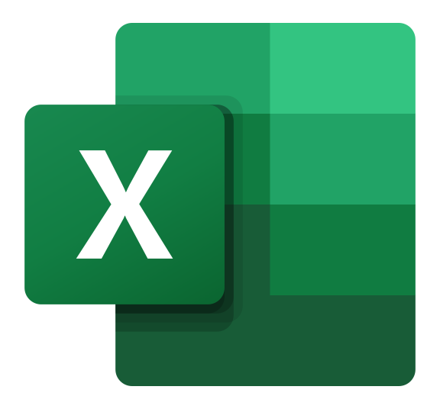
















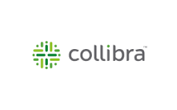
FRD → STTM AGENT · SOLUTION ARCHITECTURE
Two documents in, one model call, one workbook out — a person approves every hand-off
SOURCE SYSTEMS
DATABRICKS PLATFORM — WHERE THE AGENT RUNS
OUTPUT · DOWNSTREAM
Microsoft SharePoint
volumes + Delta tables
Draft STTM workbook
system of record — where documents are approved
.xlsx · ACFC layout · open questions flagged
FRD_<source>.docx
frds · vdds · reference_sttms · output_sttms + table frd_pairing
Every cell comes from the FRD, the VDD or the standards — target column names carried as-is from the dictionary. What cannot be sourced is a question, not a guess.
requirements — written by the BSA
Every file the agent reads or writes lives here. The review app reads this — SharePoint is never on the request path.
VDD_<source>.xlsx
the vendor's data dictionary
ACFC standards as config — naming_standards.json · engineering_standards.json — catalog and schema per layer, stage type, promoted type, audit columns
STTM_<source>.xlsx
A named reviewer decides
approved workbooks — layout only
Generation job Databricks Jobs · serverless · frd_sttm_pipeline
Resolves each open question, edits in Excel if needed, approves — and returns the workbook to SharePoint. The next sync pairs it: it becomes a layout other sources may borrow, never content. Nothing moves downstream unapproved.
Jira board / Azure DevOps
requirement stories and acceptance criteria behind the FRD
01
02
03
04
Extract
Assess
Answer
Render
Confluence / other
docx → markdown; the one Claude call returns the source-level facts. The VDD is parsed by code.
Every identifier grounded verbatim in the FRD; sources paired to dictionaries; targets per layer; blockers.
ready · needs input · cannot generate. The reviewer settles each question; answers live on run.json.
Rows from the VDD, targets from the FRD and standards, rules on the row they name — in an approved layout.
source-system notes, run books — same connector pattern
the one model call
DOWNSTREAM
One connector layer
CodeGen agent Agent 2
Entra ID app · Microsoft Graph + Atlassian REST · scoped read-only · one write folder for approved workbooks.
via Foundation Model APIs
Review app Databricks Apps
databricks-claude-opus-5 · through AI Gateway: logging, rate limits, guardrails on every call · inside the client's workspace — no external key
Pick a source · run (confirm-gated) · answer what the agent will not guess · re-render · download. Nothing is invented on the reviewer's behalf.
Reads the approved workbook — its only input from this agent — and emits the pipeline code. Unity Catalog carries the lineage from FRD to table.
00 sync on start-up — new FRD_* / VDD_* / STTM_* files are imported, paired by name — never by similarity.
ONE MODEL CALL PER RUN · EVERYTHING ELSE IS DETERMINISTIC CODE · NOTHING IS INVENTED · A PERSON APPROVES

Slide 7



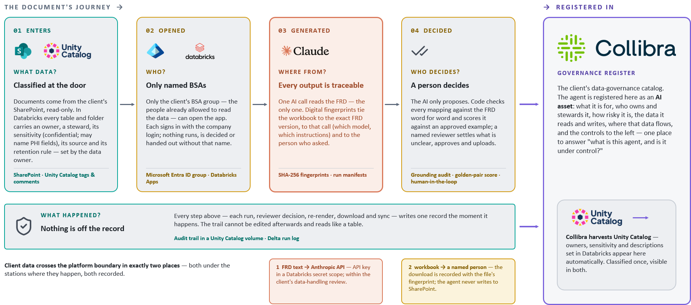
FRD → STTM AGENT · DATA GOVERNANCE ARCHITECTURE
Classified data · named people · traceable outputs · a person decides · a record of everything
THE DOCUMENT'S JOURNEY →
→ REGISTERED IN
01 ENTERS
02 OPENED
03 GENERATED
04 DECIDED
GOVERNANCE REGISTER
WHAT DATA?
WHO?
WHERE FROM?
WHO DECIDES?
The client's data-governance catalog. The agent is registered here as an AI asset — one place to answer “what is this agent, and is it under control?”
Classified at the door
Only named people
Every cell has a source
A person decides
Two documents per source — the FRD and the vendor's data dictionary — arrive from SharePoint read-only and land in Unity Catalog volumes. Every volume and table carries an owner, a steward, its sensitivity (the dictionary flags PHI columns) and a retention rule, set by the data owner.
Only the client's BSA group — the people already allowed to read this data — can open the review app. Each signs in with the company login; nothing runs, is decided or is handed out without that name. May run equals may read.
One Claude call reads the FRD — the only one in the system. Every identifier it returns must appear word-for-word in the FRD or becomes a question. Column names are carried as-is from the dictionary; the agent never opens the source's own approved workbook; a missing dictionary blocks the run.
The AI only proposes. Code computes the verdict — ready, needs input, cannot generate — and lists what it would not guess. A named reviewer answers each question (keep · remove · correct); the answers are recorded and survive a re-run of the same document. Approval is the reviewer's upload.
Collibra harvests Unity Catalog — owners, sensitivity and descriptions set in Databricks appear here automatically. Classified once, visible in both.
SharePoint read-only · Unity Catalog tags
Microsoft Entra ID group · Databricks Apps
verbatim grounding · three sources or a question
run.json · human-in-the-loop
WHAT IS REGISTERED
WHAT HAPPENED?
Every run, every reviewer answer, every render and download is written as a record in Unity Catalog the moment it happens. The trail reads like a table and cannot be edited afterwards.
What the agent is for, and its risk tier
Nothing is off the record
Audit trail · Delta run log · a person's name on every action
Who owns it and who stewards it
The data it reads and writes, and where it flows
Client data crosses the platform boundary in exactly two places — both under the stations where they happen, both recorded.
1 FRD text → Claude
2 workbook → a named person
The five controls shown to the left
Through the workspace's Foundation Model APIs and AI Gateway — inside the client's Databricks tenant, logged per call, no external key. Within the client's data-handling review.
The download is recorded with the workbook's fingerprint and the reviewer's name. The reviewer — not the agent — returns the approved workbook to SharePoint.
CLASSIFIED DATA · NAMED PEOPLE · TRACEABLE OUTPUTS · A PERSON DECIDES · A RECORD OF EVERYTHING

Slide 8
STTM Agent Demo

Slide 9
CodeGen/Data Pipeline Agent
Two agents, one relay — from an approved FRD through to generated pipeline code
STTM
Agent 2
CodeGen
Pipeline code
transforms, DDL,
tests, job config
human gate
The FRD is authored and approved by your team. Agent 1's workbook is Agent 2's input — and nothing moves downstream until a named person approves it.
FRDs and STTM workbooks are read from, and written back to, the AmeriHealth SharePoint document library through the Microsoft Graph API.
The AI only ever drafts
Every outcome cites its source
A named person signs off
Validation, grounding, gating and rendering are all ordinary code. The model is never the arbiter of whether its own output is right.
A value that cannot be found word-for-word in the source document fails the run — it is never quietly invented or approximated.
Each agent stops at a review gate before its output moves on. Decisions are recorded and survive re-runs of the same document.
Where both agents run
Lakeflow Declarative Pipelines
Unity Catalog
Model Serving / AI Gateway
Databricks Apps
one pipeline per agent; each stage re-runnable
Delta tables and Volumes own every artifact
the Claude-family endpoint each agent calls
the review surface where a person decides
3

Slide 10





CodeGen Agent Architecture
The approved STTM becomes deployable artefacts — a PySpark notebook, or DDL and SQL for the existing ingestion framework
Engineer starts a run
GENERATED · DRAFT
SOURCE INPUTS
Databricks app · one approved STTM per run
OPTION A · NOTEBOOK
Approved STTM, FRD
PySpark notebook
Signed-off mapping from the STTM agent
Runs natively on Databricks
or
Connector layer
CodeGen Agent
OPTION B · INGESTION FRAMEWORK
Data Structures
Databricks serverless job
four stages · one model call
DDL scripts
Target schemas, DDL & naming standards
MCP services expose each system through one pattern
.xlsx · target table definitions
SQL insert statements
Collibra
Ingest
Generate
Test · Gate
Package
.xlsx · config rows for the framework DB
Glossary, classifications & data policies
PySpark notebook
MODEL ACCESS · GOVERNED RUNTIME
Updates to reusable notebook
Reference library
Unity AI Gateway
Naming and coding standards, sample notebooks
routing · guardrails · rate limits · cost & audit on every call
Foundation Model APIs
Unity Catalog
The one model call — pay per token
Schemas · lineage · run history
Engineering review — the merge gate
ON APPROVAL
Notebook merged to the repo via pull request — usual SDLC controls
2
Engineers read the generated code, run it against test data, and approve. Nothing merges unreviewed.
DDL & SQL loaded into the existing ingestion framework database

Slide 11


HEXAWARE · AMERIHEALTH CARITAS · AGENT 02 / 03
CodeGen Agent data governance architecture
THE CONTRACT'S JOURNEY ↓
→ REGISTERED IN
01 ENTERS
WHAT DATA?
Generation reads only machine-readable contracts approved upstream — feed facts from the FRD, column mappings from the STTM. No raw client documents live in this repo; PHI fields arrive flagged and are masked to last-4 at every egress.
SharePoint read-only · frozen pydantic contracts
Approved STTMs and FRDs
GOVERNANCE REGISTER
02 OPENED
WHO?
SharePoint is reached as a registered Entra application with Sites.Selected on one site; writes are limited to a single output folder. Fetch and publish are explicit human steps — a re-generate is never a re-publish.
Microsoft Entra ID app · Sites.Selected · one write folder
The client's data-governance catalog. The agent is registered here as an AI asset: what it is for, who owns and stewards it, how risky it is, the contracts it reads, the code it writes, where that flows, and the controls to the left — one place to answer "what is this agent, and is it under control?"
Named identities only
03 GENERATED
WHERE FROM?
Deterministic templates render everything the contracts state — same contracts in, same bytes out. Only rule text code cannot map reaches the model; every citation must appear verbatim in the contract or the suggestion is marked ungrounded.
provenance banners · SHA-256 · verbatim grounding
Every file is traceable
04 DECIDED
WHO DECIDES?
The AI only suggests. Code computes each feed's verdict — PASS, PASS_WITH_FLAGS or FAIL — and model candidates land in a review file, never in generated code. A named engineer confirms flags, implements approvals, raises the PR.
gate verdict · candidates.json · human-in-the-loop
An engineer decides
WHAT HAPPENED?
Every generated file names the exact contracts and SHA-256 fingerprints that produced it; a per-feed report records every rule, its grounding, every model suggestion and the gate verdict.
Generated DDL is Unity Catalog-native — the Delta tables it declares carry owners and sensitivity, harvested into Collibra automatically. Classified once, visible in both.
Nothing is off the record
reports/<feed>.md · provenance banners · byte-stable renders
Client data crosses the repo boundary in exactly two places — both deliberate, both under the stations above, both recorded.
1 unmapped rule text → Anthropic API — mock by default: zero network without a key; the key lives only in the environment, never the repo.
2 artifacts → SharePoint — a separate, confirm-gated publish to one output folder; every file carries its provenance banner.
approved contracts · named identities · traceable files · an engineer decides · a record of everything
CONTROLS BUILT 2026-08-24 · COLLIBRA ENTRY PENDING
Notes:
Two-layer trust rule: templates write code; the model only advises on rules templates cannot cover.

Slide 12
STTM Agent Demo

Slide 13
NEXT STEPS
Prioritizing CodeGen agent to train on various frameworks and project specific templates.
  Ex: Ingestion framework, EDH Framework(aka V-query), CMS Framework
Engaging Architecture Team
Engage Platform Team
Engage AI COE
Deciding on SQL Server DB vs Databricks Lakebase database for Audit or pipeline orchestration
Action Items
2

Slide 14

Thank you
Two agents. One governed platform. Every hand-off approved by a person.

Slide 15


FRD → STTM Agent solution architecture
SYSTEM OF RECORD
Microsoft SharePoint
FRD_<name>.docx
STTM_<name>.xlsx
Entra ID app
Microsoft Graph
Sites.Selected · read
The client's document library — the only place anything is authored or approved.
input — approved requirements
input — becomes a template
00 sync on app start-up — imports every FRD_* / STTM_* not yet in Unity Catalog · never writes back
DATA PLATFORM
Databricks — Jobs run the pipeline, Apps serve the reviewer, Unity Catalog holds every file and table.
approved STTM goes back
Generation job Databricks Jobs · serverless · stages 01–04
Review app Databricks Apps
01
02
03
04
Volumes — FRDs, approved STTMs, the corpus index, every run's artifacts
frd_raw · sttm_reference · sttm_out
Delta tables — run history and contracts
Ingest
Extract
Audit · gate
Render
On start-up: syncs SharePoint → Unity Catalog. Then pick an FRD · run (confirm-gated) · answer what the agent could not settle · re-render · download.
docx → markdown
the one model call
verbatim grounding
STTM + contract
draft STTM .xlsx + feed contract .json → to a person
HUMAN REVIEW
OUTPUTS · DOWNSTREAM
The reviewer approves the STTM (edits in Excel if needed) and uploads it to SharePoint themselves. The next start-up sync pairs it — it becomes a template.
STTM workbook
.xlsx · client dialect
Feed contract
contract.json · machine-readable
CodeGen agent
Code Review agent
the model proposes · deterministic code audits and decides · a person resolves

Slide 16
HEXAWARE · AMERIHEALTH CARITAS · AGENT 02 / 03
HEXAWARE · AMERIHEALTH CARITAS · AGENT 02 / 03
CodeGen Agent solution architecture
CodeGen Agent solution architecture
THE PIPELINE →
THE PIPELINE →
SYSTEM OF RECORD
SYSTEM OF RECORD
GENERATION ENGINE
GENERATION ENGINE
HUMAN REVIEW
HUMAN REVIEW
OUTPUTS · DOWNSTREAM
OUTPUTS · DOWNSTREAM
codegen CLI offline · byte-stable
codegen CLI offline · byte-stable
Demo app FastAPI · React
Demo app FastAPI · React
Pipeline + notebook
PySpark · DDL · job · tests
Microsoft
SharePoint
Pipeline + notebook
PySpark · DDL · job · tests
Microsoft
SharePoint
Deterministic Jinja2 renders everything the contracts state; the model only sees what code cannot map.
Deterministic Jinja2 renders everything the contracts state; the model only sees what code cannot map.
Report + candidates
report.md · candidates.json
Pick a contract pair · run · read the gate verdict · approve / reject model candidates · publish behind an explicit confirm.
Report + candidates
report.md · candidates.json
The program's document library — approved contracts and workbooks in, generated artifacts out.
Pick a contract pair · run · read the gate verdict · approve / reject model candidates · publish behind an explicit confirm.
The program's document library — approved contracts and workbooks in, generated artifacts out.
Resolve
01
Resolve
01
FRD ⋈ STTM → frozen spec
FRD ⋈ STTM → frozen spec
Every file carries a provenance banner — the contract names and sha256 that produced it.
Every file carries a provenance banner — the contract names and sha256 that produced it.
FRD_<name>.contract.json
input — feed-level facts
FRD_<name>.contract.json
input — feed-level facts
Compile rules
02
Compile rules
02
The engineer decides
no-LLM classifier
The engineer decides
no-LLM classifier
Reason
03
Reason
03
Reads the verdict — PASS / PASS_WITH_FLAGS / FAIL — confirms flagged rules, implements approved candidates, and raises the PR. Nothing under out/ is ever hand-edited.
STTM_<name>.xlsx
input — column mappings
Reads the verdict — PASS / PASS_WITH_FLAGS / FAIL — confirms flagged rules, implements approved candidates, and raises the PR. Nothing under out/ is ever hand-edited.
STTM_<name>.xlsx
input — column mappings
Code Review agent
reviews what this agent emits — via an engineer-owned PR
the one model call
Code Review agent
reviews what this agent emits — via an engineer-owned PR
the one model call
Emit · gate
04
Emit · gate
Entra ID app · Microsoft Graph
Sites.Selected · one write folder
04
Entra ID app · Microsoft Graph
Sites.Selected · one write folder
Jinja2 → verdict
Jinja2 → verdict
The gate pre-flights its checks: ruff, debug scan, secrets scan, test-per-module, tests.
The gate pre-flights its checks: ruff, debug scan, secrets scan, test-per-module, tests.
mock by default · only unmapped rule text · suggestions land in candidates.json, never in code
mock by default · only unmapped rule text · suggestions land in candidates.json, never in code
00 sharepoint-fetch pull is explicit · publish is a separate, confirm-gated step · a re-generate is never a re-publish
00 sharepoint-fetch pull is explicit · publish is a separate, confirm-gated step · a re-generate is never a re-publish
gate verdict · candidates.json · engineer-owned PR
gate verdict · candidates.json · engineer-owned PR
PUBLISH BACK
PUBLISH BACK
sharepoint-publish — the engineer returns pipeline, notebook and report to the library's single output folder (file names qualified per feed). The write grant covers only that folder — and the next fetch reads the same library.
sharepoint-publish — the engineer returns pipeline, notebook and report to the library's single output folder (file names qualified per feed). The write grant covers only that folder — and the next fetch reads the same library.
artifacts flow back ←
artifacts flow back ←
deterministic code renders · the model only suggests · an engineer decides and ships
deterministic code renders · the model only suggests · an engineer decides and ships

